Slide 1
2023-2024 Request for Proposals Webinar
AIDS United | Southern HIV Impact Fund
September 14 & 20, 2023
3 PM ET / 2 PM CT

Slide 2
RECORDING IN PROGRESS
A copy of the recording and slides will be provided after today’s session.
Everyone has been placed on mute.
Please use the chat box on your screen and/or select the raise your hand button to ask a question.

Slide 3
Meet Our Team
Vanessa Lathan
(she/her)
Sr. Program Manager, SHIF
Clifford Castleberry
(he/him)
Program Associate, SHIF
Vienna Mbagaya
(she/her)
Sr. Manager of Impact & Evaluation

Slide 4
AIDS UNITED
History: AIDS United’s grantmaking portfolio dates back to the founding of the National AIDS Fund in 1988. For more than two decades, we have supported community-driven responses to the HIV epidemic around the country that reach the nation’s most disproportionately affected populations, including gay and bisexual men, communities of color, women, people living in the deep South, and people living with HIV/AIDS.
Mission: AIDS United’s mission is to end the HIV epidemic in the United states.
Vision: AIDS United envisions a time when all people, governments, and organizations commit to ending the epidemic and strengthening the health, well-being, and human rights of everyone impacted by HIV.
North Star: The voices of people living with and vulnerable to HIV always guide our work.

Slide 5
Southern HIV Impact Fund (SHIF) Overview
In 2017, Funders Concerned about AIDS formed a group of key funders: Gilead Sciences, Elton John AIDS Foundation, ViiV Healthcare, and Johnson & Johnson.
SHIF is currently administered by AIDS United – the nation's leading organization advocating for a coordinated response to HIV in partnership with community-based groups around the country.
Year 7 (2023-2024) is currently supported by Gilead Sciences, ViiV Healthcare, and a generous anonymous donor.

Slide 6
SHIF Year 7 (2023-2024)
Grant Start: November 1, 2023
Grant End: October 31, 2024

Slide 7
Year 7 (2023-2024) Overview
This year we are not using the AIDS United Grant Portal
There is $1.2 million available for the 2023-2024 cycle.
SHIF anticipates funding approximately 25 organizations with grants of up to $60,000.00.
There are two grant types available:
Project Specific: to support a distinct project with clear goals, objectives, activities, and measurable outcomes.
General Operating: provides financial resources to an organization in support of its mission and overall activities, including operating expenses and overhead, rather than providing support for specific projects or programs.

Slide 8
Eligibility To be eligible for funding through SHIF, the applicant must meet the following criteria:
Nonprofit Status
Applicants must be nonprofit, tax-exempt organizations, per the guidelines set forth by the Internal Revenue Service, with proper 501(c)(3) status, or hold 501(c)(7) status. Organizations or coalitions that do not hold 501(c)(3) or 501(c)(7) status must have a fiscal sponsor. Note that 501(c)(4) designation is not the same. While it is possible for an organization to have both IRS (c)(3) and (c)(4) status, AIDS United will verify that each applicant organization has a (c)(3) designation.
Geographic Location
Applicants must have a staff member located in and provide services within the Southern United States. For this opportunity, the South is defined as: Alabama, Georgia, Florida, Louisiana, Mississippi, North Carolina, South Carolina, Tennessee, and Texas.
Financial Stability
Organizations should be fiscally stable and viable before submission of the funding application.
Operating Budget
There are not organizational annual operating budget limitations on this funding; organizations are eligible to apply regardless of their annual operating budget amount. However, funding for small, grassroots organizations will be prioritized.
Equity
SHIF recognizes that HIV outcomes are significantly impacted by systemic racism, poverty, homophobia, and transphobia, heterosexism, and misogyny. As such, we will prioritize funding for organizations led by, majority staffed with, and serving Black and Latinx transgender folx; gender-nonconforming and nonbinary + people; Black and Latinx gay, bisexual, queer, and same-gender-loving men +; Black women; youth of color, other communities of color; and gender identities and sexual orientations of people of color that letters and words cannot fully describe.
Good Standing
Current or previous grantees of any AIDS United funding portfolio must be in good standing with regard to reporting and all other grant requirements.
Grant Period
Applicants must be able to utilize the funds within a 12-month period beginning November 1, 2023 and ending October 31, 2024.
Protection of Information
All applicants will be required to provide a plan to protect patient information, including following guidelines in the Health Insurance Portability and Accountability Act of 1996 (HIPAA), as applicable.
Relationship to AIDS United
Current AIDS United grantees, including current and past grantees of iFORWARD and/or the Southern HIV Impact Fund, are eligible to apply. Organizations that have not been funded by AIDS United before are also eligible to apply.

Slide 9
Restrictions
Grant funds may NOT be used for:
direct or grassroots lobbying;
medications or medical care;
facility acquisition or renovation;
deficit reduction or debt payment;
displacement of existing funding sources;
and indirect expenses outside of the percentage noted in your budget.

Slide 10
Submission Options & Timeline
Written applications will be submitted via AIDS United’s online Qualtrics by 6 p.m. EST on Oct 2, 2023. Questions do not have a word limit. However, applicants should aim for written responses to the Application Narrative questions to be no longer than ten pages, single-spaced.
Applicants can submit a pre-recorded video that is no longer than 60 minutes in length, responding to the Application Narrative Questions. Videos should be sent to southernfund@aidsunited.org by 6 p.m. EST on October 2, 2023. Please send an email with a link to your video housed on a file sharing service like Google Docs, Dropbox or a similar service and include the name of your organization both in the filename and in the email subject.
Applicants can answer all Application Narrative questions in a live 60-minute Zoom call with AIDS United staff by 4:00 pm EST on September 28, 2023. The link to book a ZOOM call is located on the full RFP.

Slide 11
Qualtrics Walkthrough
Bianca Carrillo (she/her/Ella)
Manager of Strategic Projects

Slide 12
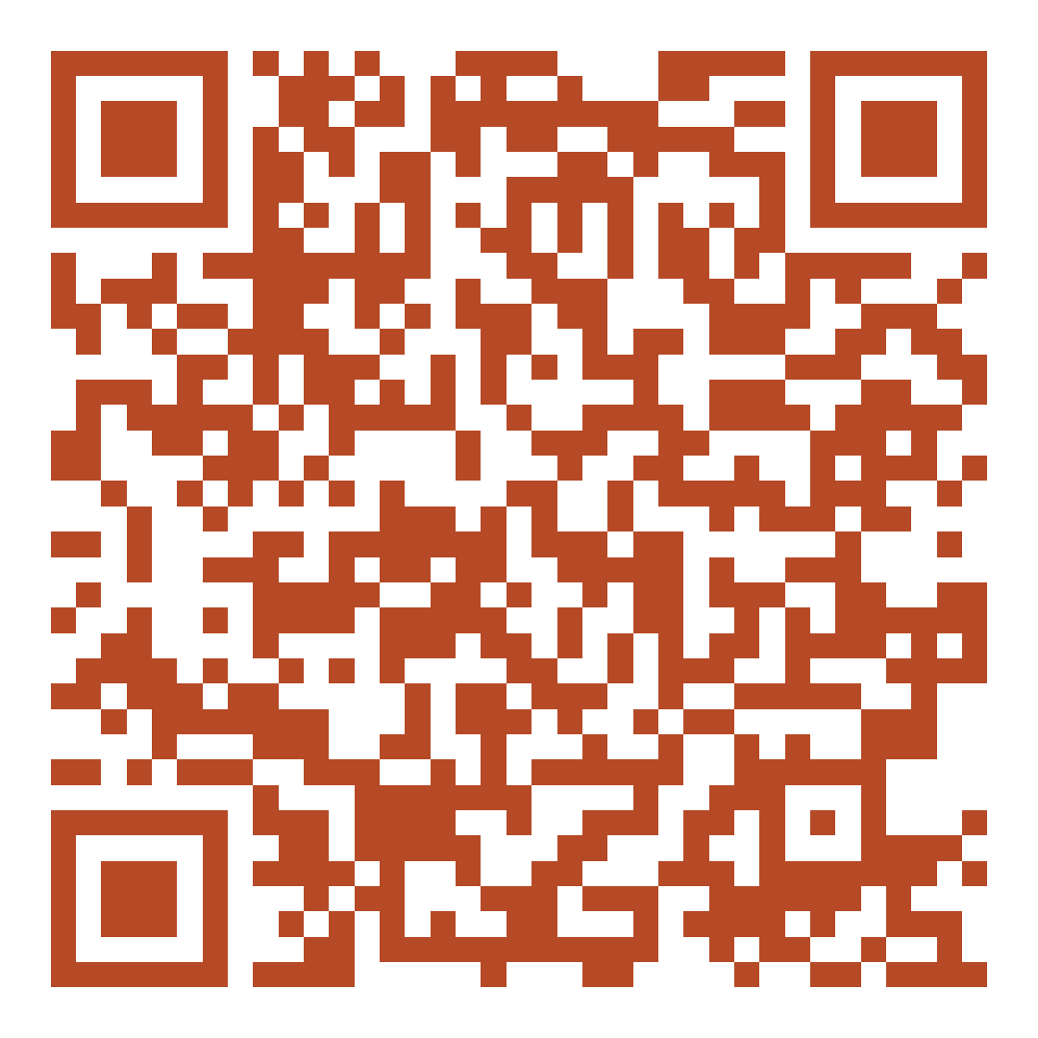
Application Overview
Organizational Overview
Organizational Leadership
Grant Request Overview
Application Narrative
Scan here to view the 2023-2024 RFP.
The application questions are on page 6.

Slide 13
Required Attachments
Budget
Representation Table
Annual Operating Budget
Board of Directors List
Most recent audited financial statements (or your fiscal sponsor’s)
Fiscal Sponsor Agreement (if applicable)
Memoranda of Agreement of Letters of Support (optional)
Implementation Plan (Project-specific only)
Scan here to view the 2023-2024 RFP.
The list of attachments is on page 10.

Slide 14
Year 7 (2023-2024) Timeline*
November 15, 2023
Year 7 Welcome Webinar
April 2024
Attendance at an in-person All Grantee Convening (official dates TBD)
Upon signing grant agreement
Funded partners will receive 50% of their grant award
Baseline Report due
Up to 2 people from each organization will be asked to participate
May 31, 2024
Interim Reports Due
October 2024
Attendance at a virtual Fall All Grantee Convening
Narrative & Expenditure (all grantees)
December 1, 2024
Final Reports Due
Narrative & Expenditure (all grantees)
*This list doesn’t include quarterly check-in calls, participation in other grantee meetings, participation in technical assistance activities, site visits, audits, and completion of surveys. For more information on these, please review the full RFP.

Slide 15
Funded Partner Requirements
Participation in Evaluation
Grantees will be asked to report the number of unduplicated beneficiaries (for grantees who receive general operating support) or the number of unduplicated beneficiaries within each category of work (for grantees who receive project support), as well as the demographic information (age, race/ethnicity, gender identity, HIV status and sexual orientation) of each beneficiary.
Participation in Technical Assistance
Grantees will be asked to complete a series of virtual courses intended to help strengthen the organization's sustainability and growth, participate in networking with fellow cohort members, grantee convenings, and engage in 1-1 coaching sessions if needed throughout the entire grant cycle.
Grantees may apply to waive the requirement to collect sensitive information in up to two of these categories if they can provide a reasonable justification about why they cannot collect it.

Slide 16
For Technical Assistance During the Application Process
For assistance navigating the application or other technical issues, please contact grants@aidsunited.org.
For all other inquiries or questions, please contact the SHIF team at southernfund@aidsunited.org

Slide 17
Any Questions?

Slide 18
Items Needed for Submission
Proposal Narrative
Annual Operating Budget
Organizational Chart
Memoranda of Agreement and/or Letters of Support (required if you have partnership(s))
Board of Directors List
(or fiscal sponsor’s)
Fiscal Sponsorship Agreement
(required if applying with a fiscal sponsor)
Audit
(or fiscal sponsor’s)
Implementation Plan
(for Project-Specific requests ONLY)
Project Budget
(for Project-Specific requests ONLY)

